Slide 1


Digital Speedometer
Dheeraj Yadav
ECE-A1
1501031011

Slide 2
Content
Introduction
Requirement analysis
Proteus Diagram
ARES Diagram
PCB Layout
3-D Layout
Application
Technical Information
Conclusion
References

Slide 3
Introduction
A speedometer or a speed meter is a gauge that measures and displays the instantaneous speed of a vehicle.
Many modern speedometers are electronic. In designs derived from earlier eddy-current models, a rotation sensor mounted in the transmission delivers a series of electronic pulses whose frequency corresponds to the (average) rotational speed of the driveshaft, and therefore the vehicle's speed, assuming the wheels have full traction. The sensor is typically a set of one or more magnets mounted on the output shaft or (in transaxles) differential crown wheel, or a toothed metal disk positioned between a magnet and a magnetic field sensor. As the part in question turns, the magnets or teeth pass beneath the sensor, each time producing a pulse in the sensor as they affect the strength of the magnetic field it is measuring.
A computer converts the pulses to a speed and displays this speed on an electronically controlled, analog-style needle or a digital display

Slide 4
Requirement Analysis
Arduino Uno
Hall Sensor
Hall Sensor Magnet
Electronics LCD
9-V Battery
PCB
Variable Resistance
220K Resistance
Headers

Slide 5
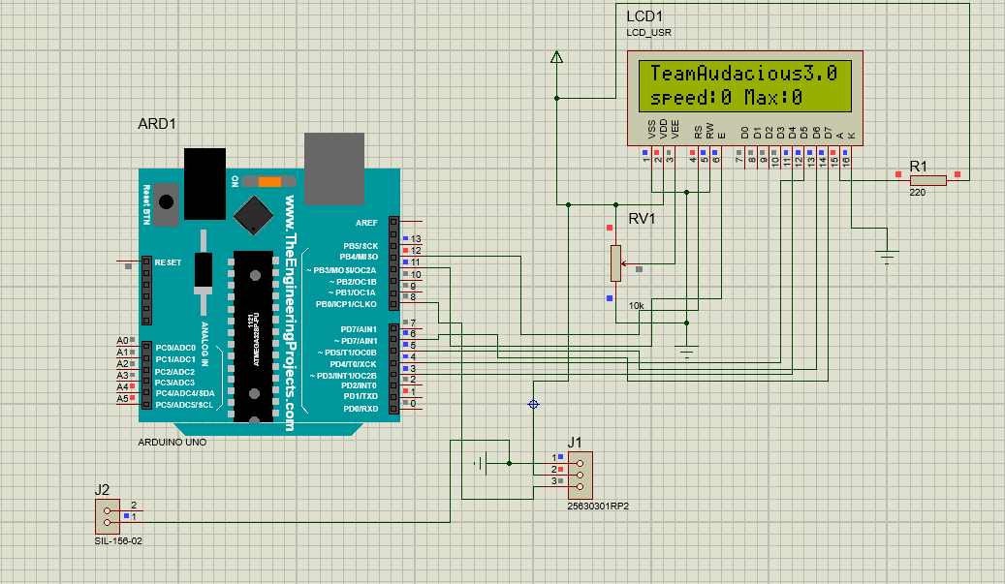
Proteus Diagram

Slide 6
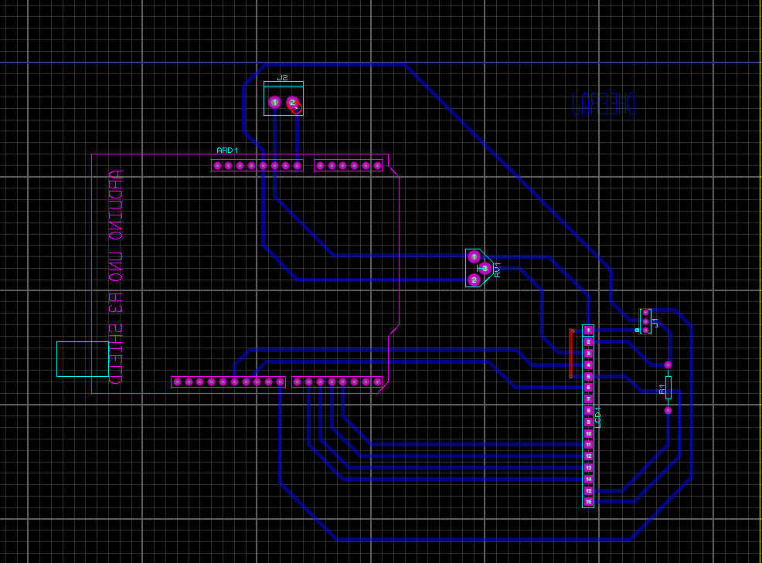
ARES Diagram

Slide 7
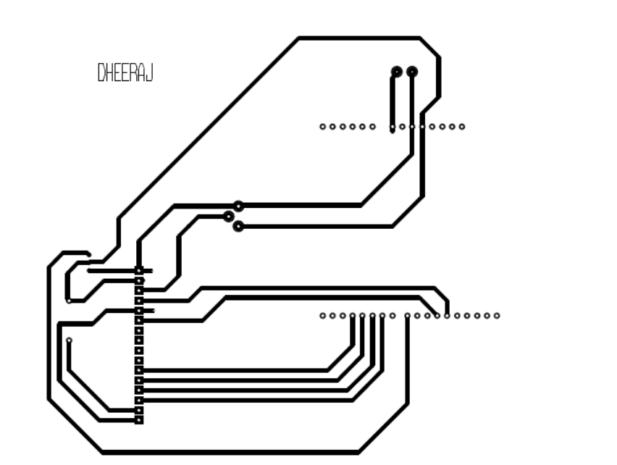
PCB Layout

Slide 8
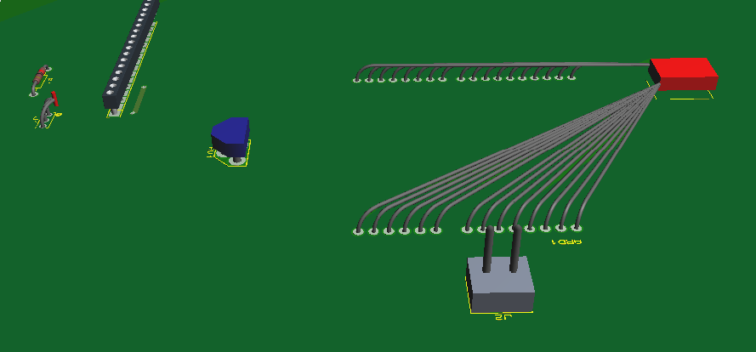
3-D View

Slide 9
Application
The accurate data recording and indication meet the
stringent requirements of national and EU-wide regulations.
Vehicles subject to tachograph regulations with separate
indication and recording.
Indication of total distance travelled in the 7-digit LC display
with 100 meter digit.
Speed pointer set to the legally required tolerance.
Weight factor <<300gm

Slide 10

Technical Information
Measuring range 125 km/h
Operating temperature - 25 ... + 70 °C
Operating voltage 5v or 3.3v
Inputs Hall sensor
Outputs 2 x v-pulse, 4 Imp/M, driving/stop signal
Accuracy Speed pointer set to the legally required tolerance
Design on PCB
weight approx 300gm

Slide 11
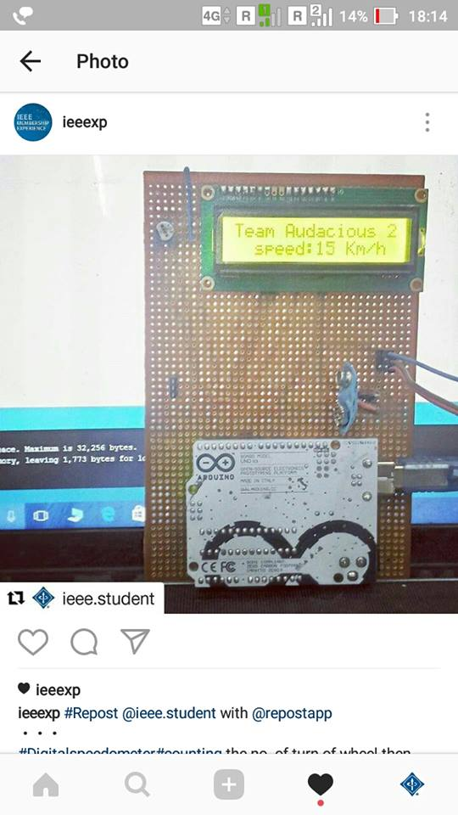
Conclusion
By the Digital Speedometer we can control over speed of vehicle and the main thing is by the use of this the consumption of fuel is decrease.

